Slide 1





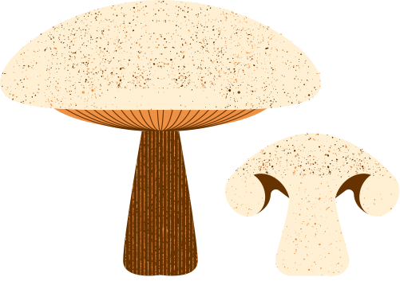


Done by:
Mohamed Amine Fakhre-Eddine
Abdelali Ibn Tabet
Nouhaila Krimel
Soueilem Mohamed Abd Nasir
Food security in Morocco
Notes:
Greetings to all, This presentation displays our progress on the topic of food security in morocco

Slide 2

Overview
Introduction
Recap
Methodology
UX
UI
ARIMA process preview
Conclusion

Slide 3



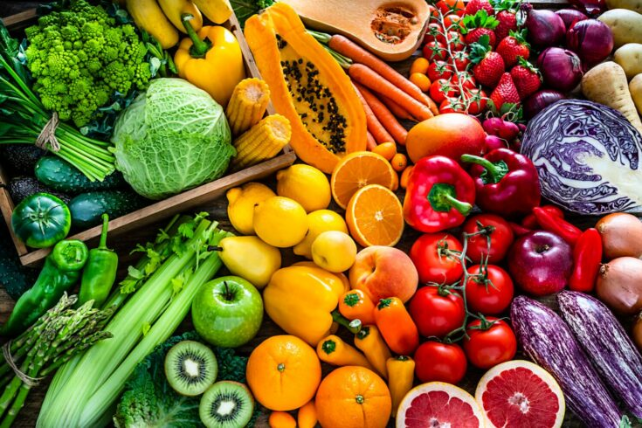
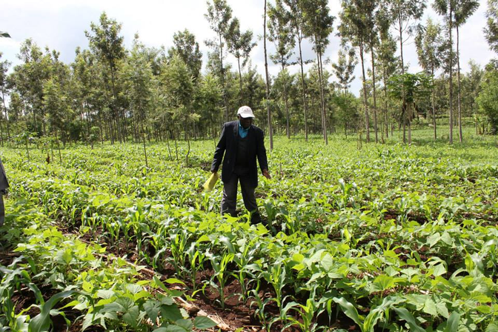


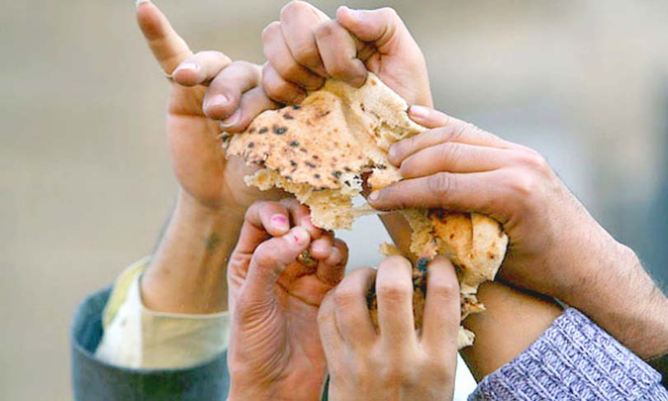
Introduction
Notes:
Morocco faces significant challenges in distributing food supplies, despite its extensive agricultural resources. To address this issue, an initiative is being developed to use artificial intelligence (AI) not only to address uneven distribution but also to establish a long-term, data-driven framework for future policy and decision-making, ultimately improving food security for the entire nation.

Slide 4

Problematic
Objectives
Optimize Resource Allocation
Agricultural Productivity
Reduce Surpluses and Shortages
Regional Disparities
Inefficiencies in Food Distribution
Enhance Food Security
Improve Access to Market Information
Resource Utilization
Ensure Adaptability and Scalability
Notes:
Morocco's food distribution system faces challenges due to the interplay of agricultural productivity, regional needs, and inefficiencies. Uneven distribution leads to scarcity in some regions while others face overabundance, and current management approaches often lack accuracy, resulting in inefficient resource utilization.
This raises a number of questions: How might AI be used to analyse extensive data on agricultural productivity and regional needs? What characteristics should be examined to optimise food supply allocation, taking into account aspects like consumption frequency and geographical distances between productive and needed regions? Can a data-driven strategy improve supply chain efficiency and ensure more equal resource allocation across the country?

Slide 5
Faced problems
Lack of data and ressources
Lack of collaboration from government agencies, and local communities

Slide 6



Methodology
Data Collection
Utilize production data for each region provided by the High Commission for Planning.
Note:
distribution and consumption data isn’t available for the moment.
Data Preprocessing
The data collection process involves analyzing all data files and saving the meaningful data in the right format, standardizing and cleaning to ensure consistency and accuracy, while integrating diverse datasets like agricultural production and demographics for unified analysis.
we are here
Data Analysis and Modeling
Machine learning algorithms can identify patterns and trends in agricultural production, consumption, and food distribution system imbalances. These algorithms may or may not include ARIMA (Autoregressive integrated moving average) and recurrent neural networks for time-series data analysis, Long Short-Term Memory Networks for capturing long-term dependencies in data, and exponential smoothing methods for handling trends and seasonality.
Notes:
Of course every research follows a specific methodology, ours goes as follows
(switch after 'data collection')

Slide 7
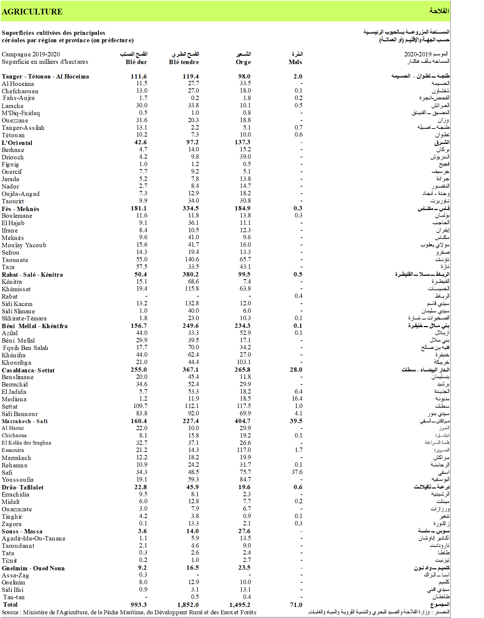
Production data example
Statistical yearbook of regions, year 2021 (Excel format) - High Commission for Planning
Notes:
passing now to data processing

Slide 8
Methodology
Data Collection
Utilize production data for each region provided by the High Commission for Planning.
Note:
distribution and consumption data isn’t available for the moment.
Data Preprocessing
The data collection process involves analyzing all data files and saving the meaningful data in the right format, standardizing and cleaning to ensure consistency and accuracy, while integrating diverse datasets like agricultural production and demographics for unified analysis.
we are here
Data Analysis and Modeling
Machine learning algorithms can identify patterns and trends in agricultural production, consumption, and food distribution system imbalances. These algorithms may or may not include ARIMA (Autoregressive integrated moving average) and recurrent neural networks for time-series data analysis, Long Short-Term Memory Networks for capturing long-term dependencies in data, and exponential smoothing methods for handling trends and seasonality.

Slide 9
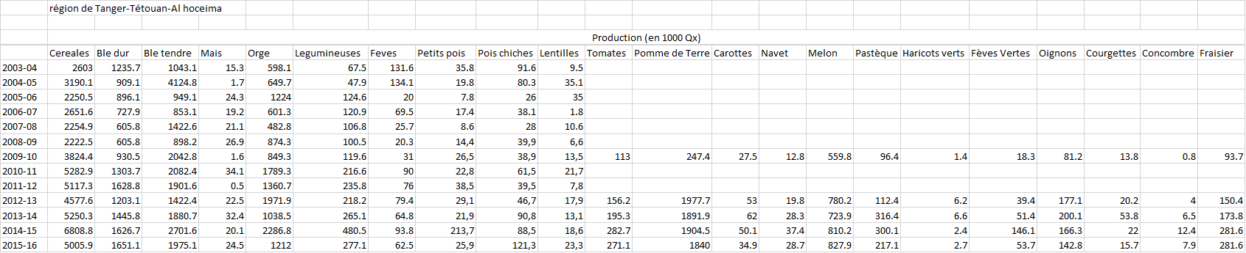
Processed production data example

Slide 10
Methodology
Data Collection
Utilize production data for each region provided by the High Commission for Planning.
Note:
distribution and consumption data isn’t available for the moment.
Data Preprocessing
The data collection process involves analyzing all data files and saving the meaningful data in the right format, standardizing and cleaning to ensure consistency and accuracy, while integrating diverse datasets like agricultural production and demographics for unified analysis.
we are here
Data Analysis and Modeling
Machine learning algorithms can identify patterns and trends in agricultural production, consumption, and food distribution system imbalances. These algorithms may or may not include ARIMA (Autoregressive integrated moving average) and recurrent neural networks for time-series data analysis, Long Short-Term Memory Networks for capturing long-term dependencies in data, and exponential smoothing methods for handling trends and seasonality.

Slide 11
ARIMA Process workflow
Find the p, d, q parameters of the ARIMA model
Train the ARIMA model
Forecast the values for the next time point
Begin
Retrain the model
Insert the new time and data point into the dataset
Notes:
There is 3 types of ARIMA, in this presentation we will cover just the standard one.

Slide 12
Methodology
Data Collection
Utilize production data for each region provided by the High Commission for Planning.
Note:
distribution and consumption data isn’t available for the moment.
Data Preprocessing
The data collection process involves analyzing all data files and saving the meaningful data in the right format, standardizing and cleaning to ensure consistency and accuracy, while integrating diverse datasets like agricultural production and demographics for unified analysis.
we are here
Data Analysis and Modeling
Machine learning algorithms can identify patterns and trends in agricultural production, consumption, and food distribution system imbalances. These algorithms may or may not include ARIMA (Autoregressive integrated moving average) and recurrent neural networks for time-series data analysis, Long Short-Term Memory Networks for capturing long-term dependencies in data, and exponential smoothing methods for handling trends and seasonality.

Slide 13
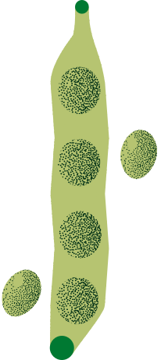
Geospatial Analysis
GIS techniques and spatial mapping are used to analyze geographical distances between production centers and consumption areas, determining transportation costs and logistical considerations.
Optimization Algorithms
Develop optimization algorithms considering production volumes, consumption patterns, and transportation costs for efficient food distribution strategies. Ensure dynamic adjustment for real-time adjustments based on changing conditions and data.
Prototype Implementation
The proposed AI-driven food distribution system will be developed into a prototype, tested using historical data to validate its effectiveness in predicting and optimizing food distribution.
Iterative Improvement
The methodology is designed to be iteratively refined and adaptable to changing agricultural and economic conditions, based on feedback from stakeholders and real-world experiences.

Slide 14
User experience workflow
Clicked home
Statistics page
Yes
Clicked login
Statistics
Yes
Landing page
Clicked?
Login page
Logged in
Login
Yes
Yes
Contact us
Contact page
Filled and submitted the contact form

Slide 15
User experience workflow
Statistics
Statistics dashboard
Clicked?
Distribution page
Clicked?
Distribution
logout
logout

Slide 16
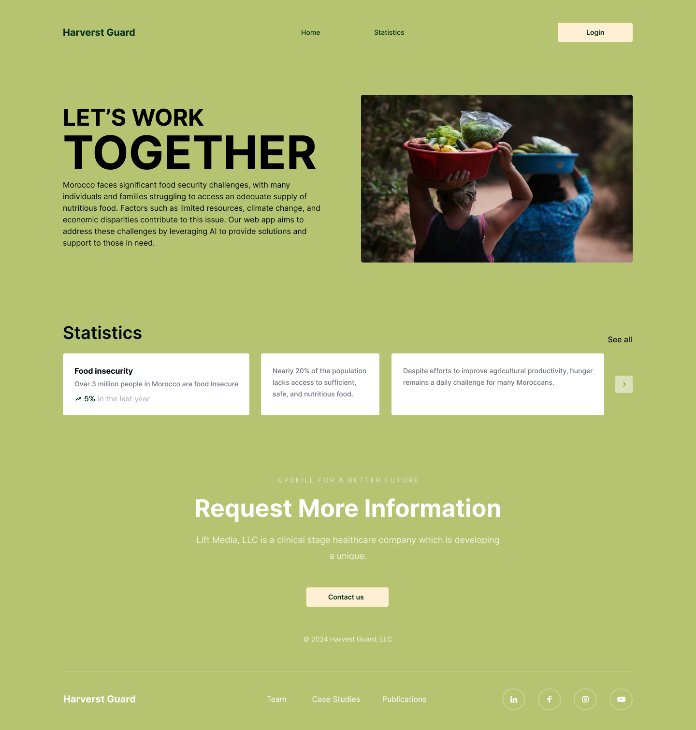
User interface - Landing page

Slide 18
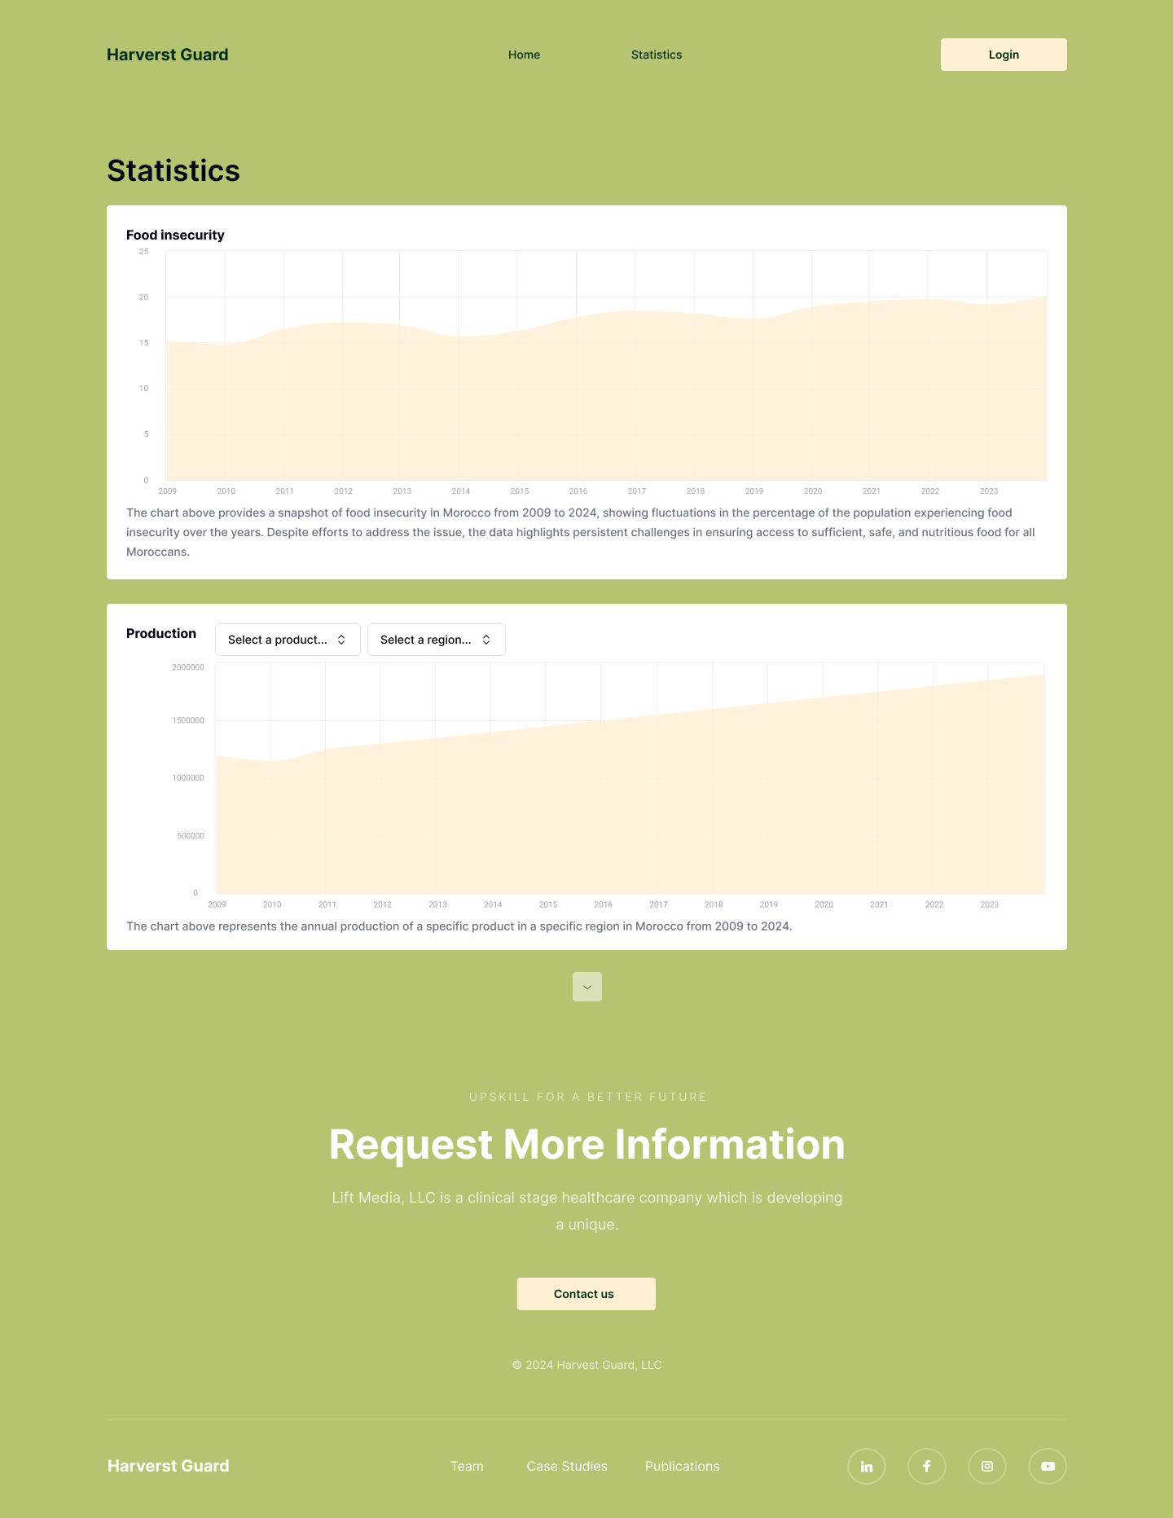
User interface - Statistics page

Slide 21

User interface - Statistics page

Slide 22
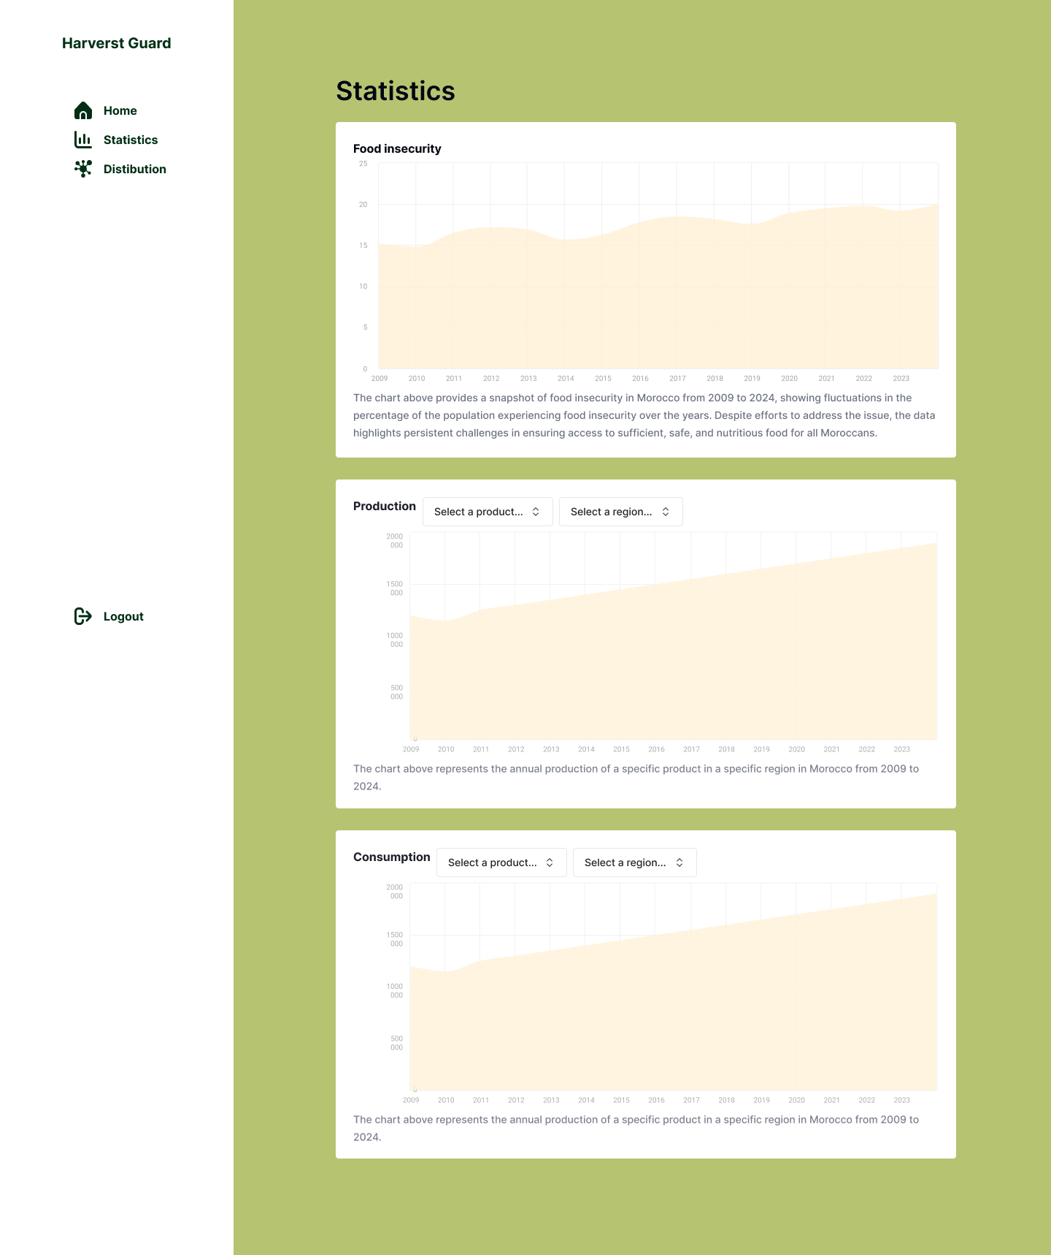
User interface - Statistics dashboard

Slide 24
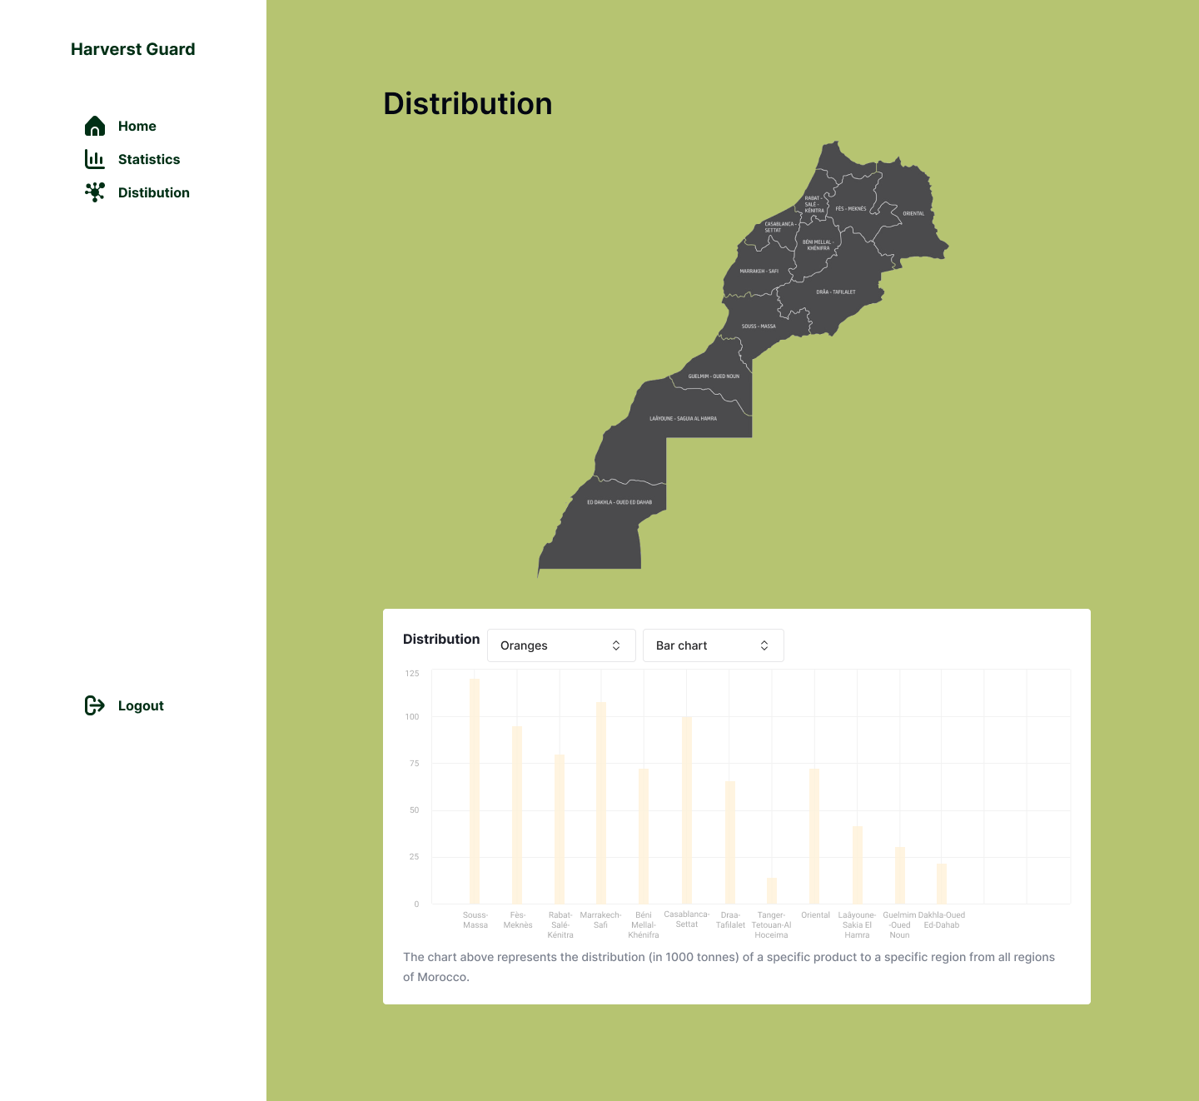
User interface - Distribution dashboard

Slide 26
ARIMA process preview

Slide 27
ARIMA process preview
ARIMA Models are specified by three order parameters: (p, d, q):
p is the order of the AR term
q is the order of the MA term
d is the number of differencing required to make the time series stationary
Notes:
AR(p) Autoregression – a regression model that utilizes the dependent relationship between a current observation and observations over a previous period. An auto regressive (AR(p)) component refers to the use of past values in the regression equation for the time series.
I(d) Integration – uses differencing of observations (subtracting an observation from observation at the previous time step) in order to make the time series stationary. Differencing involves the subtraction of the current values of a series with its previous values d number of times.
MA(q) Moving Average – a model that uses the dependency between an observation and a residual error from a moving average model applied to lagged observations. A moving average component depicts the error of the model as a combination of previous error terms. The order q represents the number of terms to be included in the model.
to define these parameters, we use differencing to make the time series stationary.

Slide 28
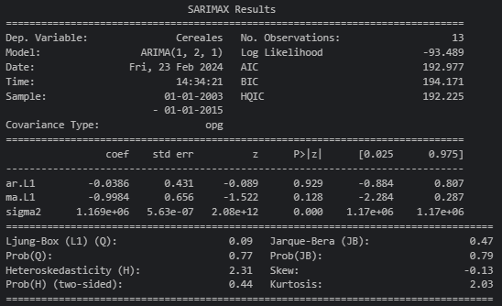
ARIMA process preview
Output
Forecast

Slide 29

Conclusion
The lack of data and ressources is the biggest obstructing barrier of our project.
Notes:
The High Commission for Planning's Statistical Yearbook of Regions provides critical data on agricultural production, but lacks information on distribution and consumption. To address this, collaboration with stakeholders, government agencies, and local communities is crucial. By obtaining comprehensive data through partnerships, surveys and investigations, we can refine our methodology and develop strategies that contribute to a more resilient and equitable food distribution system across all regions of Morocco.

Slide 30
Sources
High Commission for Planning of the Kingdom of Morocco.
https://www.hcp.ma/downloads/?tag=Annuaires+statistiques+des+r%C3%A9gions
https://www.hcp.ma/downloads/?tag=Annuaires+statistiques+du+Maroc
https://www.hcp.ma/downloads/?tag=Annuaires+statistiques+r%C3%A9gionaux
Edinburgh Research Archive, GIS – Techniques and Methods.
https://era.ed.ac.uk/bitstream/handle/1842/854/chp_2.pdf;jsessionid=8B60CEDBD5E173014299EB99ED6CA018?sequence=11

